Slide 1
Centrifugal Pump
Rudra Ghimire

Slide 2
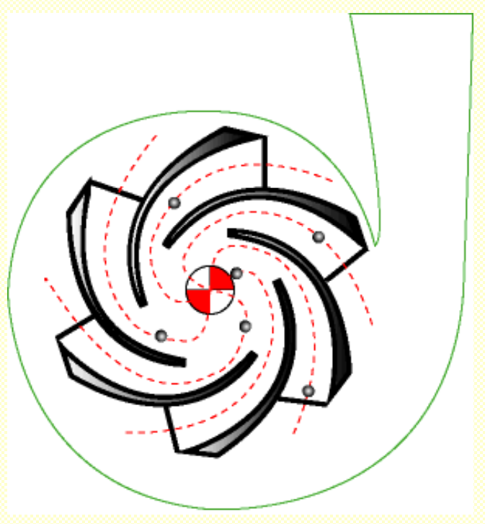
Centrifugal Pump
Centrifugal Pump can be defined as a mechanical device used to transfer liquid of various types.
As the name suggests, it relies on the principal of Centrifugal force.
It converts the energy provided by a prime mover, such as an electric motor, steam turbine, or gasoline engine, to energy within the liquid being pumped.

Slide 3
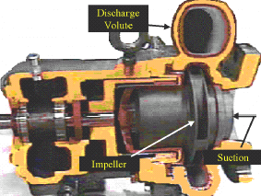
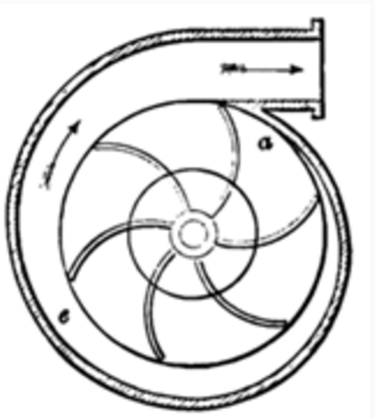
Construction of Centrifugal Pumps
Volute
1- Casing:-
Impeller
Suction
Casing generally are three types:
I. Volute casings for a higher head.
This is named from the spiral shape of the casing which is so constructed to act as a collector for the liquid as it leaves the outer edge of the impeller vanes. In volute pumps area of flow gradually increases from throat towards the delivery pipe. The increase in area of flow decreases the exit velocity and hence pressure increases in the casing.
6

Slide 4
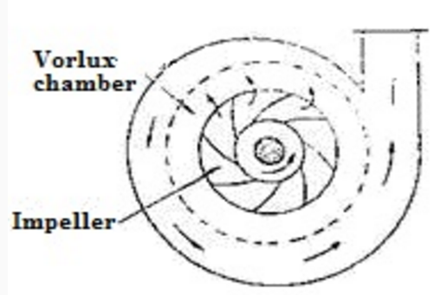
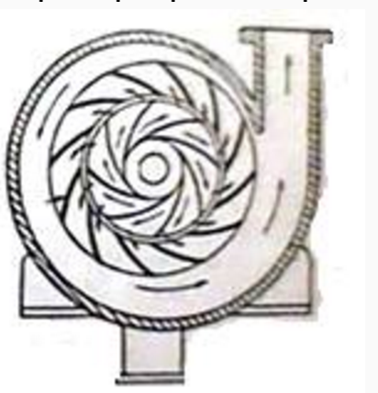
Construction of Centrifugal Pumps
II. Vortex casing
Vortex casing is a casing in which circular chamber is provided between the casing and the impeller. Vortex casing will increase pump efficiency by reducing eddies formation to a considerable extent.
III. Circular casigs
In diffuser casing, the fluid passes through a ring of fixed vanes or diffuser after the fluid has left the impeller, that diffuse the liquid, this provides a more controlled flow and a more efficient conversion of velocity head into pressure head. Providing fixed diffuser increases the efficiency of the pump up to 90 percent.

Slide 5
Rotating component
It consists of shaft and impeller. Shaft is coupled with a motor to give drive to the pump. An impeller is a rotating component of a centrifugal pump, usually made of iron, steel, bronze, brass or aluminium which transfers energy from the motor that drives the pump to the fluid being pumped by accelerating the fluid outwards from the center of rotation.

Slide 6
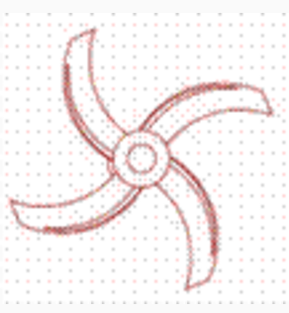

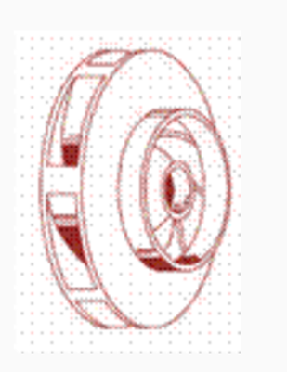
Different types of impeller
Open type impeller:
It consists of vane which accelerates the fluid. The number of vanes can vary from 2 to 8 or more.
Semi-closed impeller:
It consists of vane attached to plate on one side. Industrial application of such types of impeller is for pumping liquids containing suspensions.
Closed impeller:
The vane is enclosed by two disc or plates. Shrouds or sidewall encloses the vanes. The liquid moves in between the cavity between the vanes and plates.

Slide 7
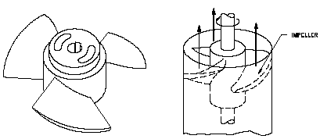
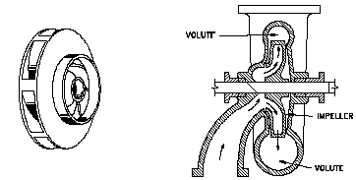
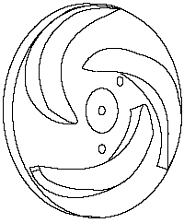
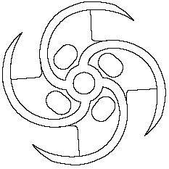
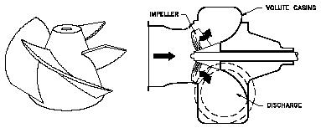
2-Impeller
Three main categories of centrifugal pumps exist
Axial flow
Radial flow
Mixed flow
7

Slide 8
Centrifugal Impellers
Impeller
Vanes
“Eye of the Impeller”
Water Entrance
Thickness
of the impeller
Diameter of
the Impeller
Thicker the Impeller- More Water
Larger the DIAMETER - More Pressure
Increase the Speed - More Water and Pressure

Slide 9
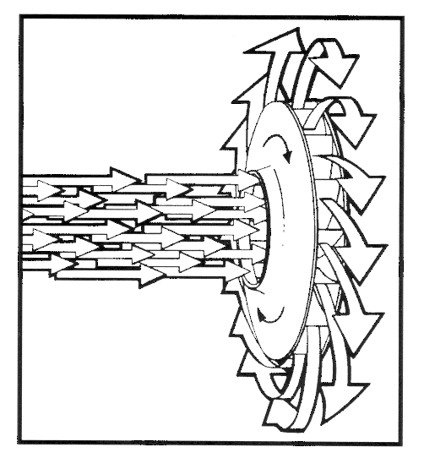
Two Impellers in Series
Direction of Flow
Twice the pressure
Same amount of water

Slide 10
Multiple Impellers in Series
Direction of Flow
Direction of Flow
Placing impellers in series increases the amount of head produced
The head produced = # of impellers x head of one impeller

Slide 11
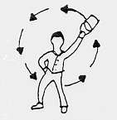

Operating Principals
As mentioned earlier, Centrifugal pump relies on the centrifugal force.
When you swing a bucket of water around over your head, you will find that as you increase the speed, the bucket is pulled harder against your arm. This pull on your arm is the centrifugal force. It makes no difference if you swing the bucket horizontal or vertical. If the speed is fast enough, then the water will remain on the bucket.

Slide 12
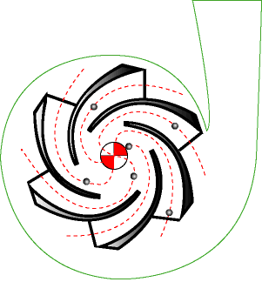
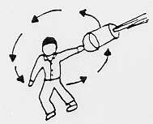
Operation Principals continued.….
If you punch a small hole on the bottom of
bucket, the water throws a stream and the distance the water travels is proportional to the centrifugal force.
The same force that kept water in the bucket, is how the simple Centrifugal pump works.

Slide 13
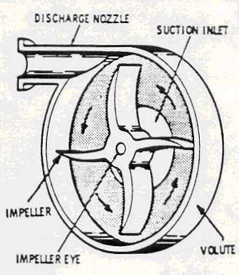
Operation Principals continued.….
Centrifugal Pump consists of a rotating impeller inside a stationary volute (casing).
Liquid enters the pump through the suction inlet into the eye of the impeller.
The speed of the rotating impeller then forces the liquid out through the discharge nozzle.

Slide 14
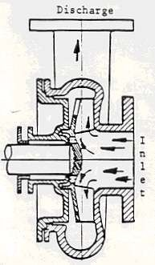

Operation Principals continued…..
The liquid enters the inlet of the centrifugal pump under atmospheric pressure, and flows into the eye of the impeller.
The Centrifugal force exerted on the liquid by the rotating impeller, moves the liquid away from
the impeller eye and out along the impeller vanes to their extreme tip where the liquid is then forced against the inside walls of the volute
and out through the discharge of the pump.
Due to the reduction of pressure occurring
at pump inlet and impeller eye, liquid is drawn
into the pump in continuous flow as it moves
through the pump.

Slide 15
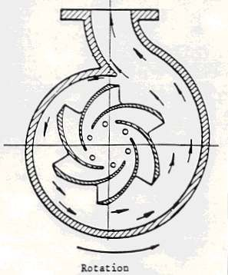

Operation Principals continued…..
The shape of the volute casing is such that it is wider at the discharge point than where the liquid is first forced by the impeller against the volute.
When the water from the impeller strikes the side of the volute, the velocity is increased. This accelerated motion is called “Kinetic Energy”, which is the energy in motion.
The shape of the volute permits the liquid to expand, which slows down the motion of the liquid. As soon as the liquid slows down inside the volute, Kinetic Energy is transformed into pressure. This pressure
then forces the liquid out of the pump discharge nozzle into the outlet pipe lines.

Slide 16
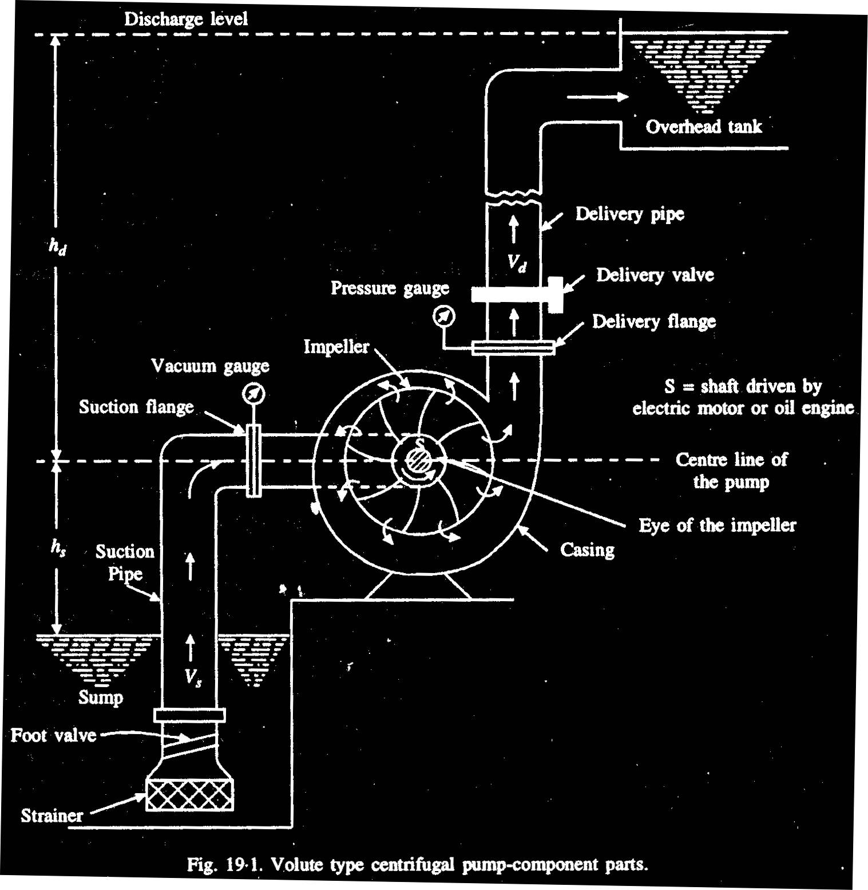
C/P connected with SP and DP

Slide 17
pump heads
Static Suction Head (hs):
It is the vertical distance between the centre of the impeller to the free surface of the water from where water is to be pumped. If the liquid level is above pump centerline, hs is positive. If the liquid level is below pump centerline, hs is negative. Negative hs condition is commonly denoted as a suction lift.
Static Discharge Head (hd):
It is the vertical distance between the pump centerline and the point of free discharge or the surface of the liquid in the discharge tank.
Total Suction Head (hs):
It is the suction reservoir pressure head (hps) plus the static suction head (hs) plus the velocity head at the pump suction flange (hvs) minus the friction head in the suction line (hfs).
HS = hps + hs + hvs + hfs
Total Discharge Head (hd):
It is the sum total of discharge reservoir pressure head (hpd), static discharge head (hd), the velocity head at the pump discharge flange (hvd) and the total friction head in the discharge line (hfd).
hd = hpd + hd + hvd + hfd

Slide 18
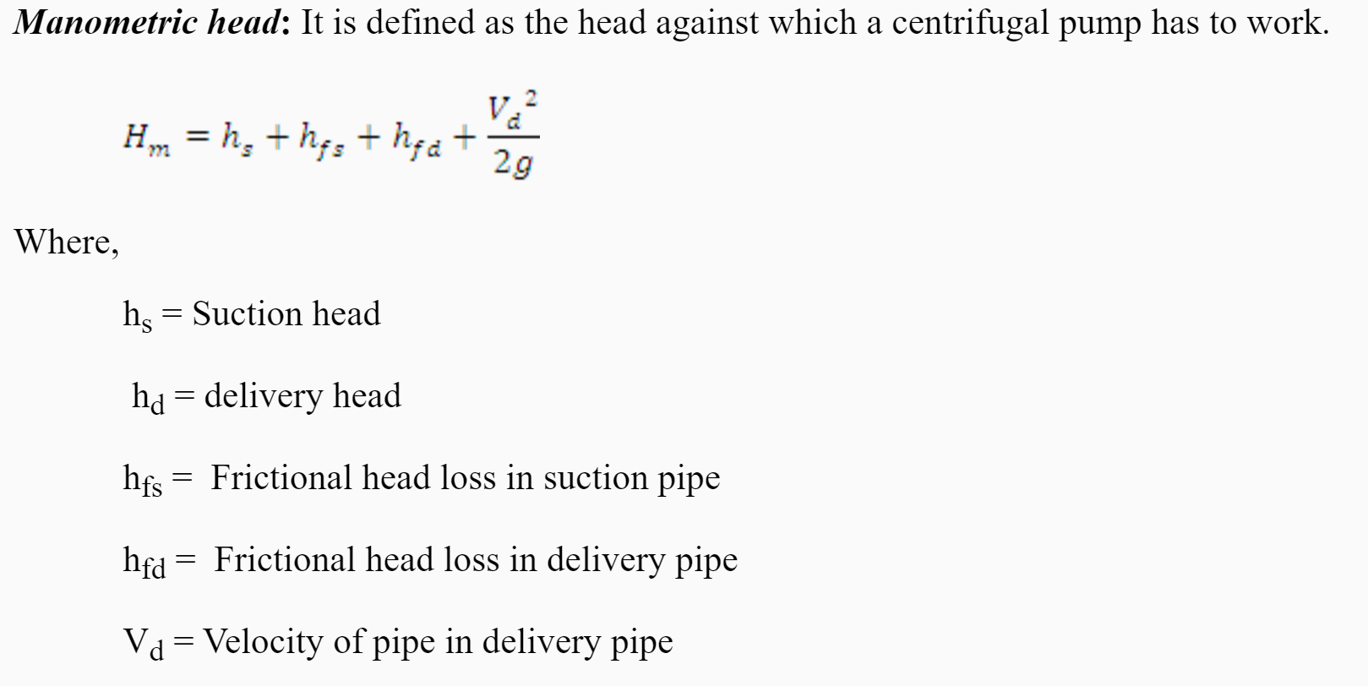
Manometric head

Slide 19
Shut off Head of pumps:
When a pump is filled with the fluid to be operated at normal speed with discharge closed, the head developed is called SH.
The force vortex create with pressure head difference between eye and impeller periphery is (u₂² –u₁²)/2g.
There is great deal of circulation within the impeller which cause rotation of fluid in all parts of impeller , eye and several distance of intake pipe. So actual shutoff head is approximately u₂² / 2g.
Shutoff head depends on impeller vane ∠ at inlet and exit and nature of intake.

Slide 20
Pump head
The head that the pump must develop
= static lift + total head loss

Slide 21
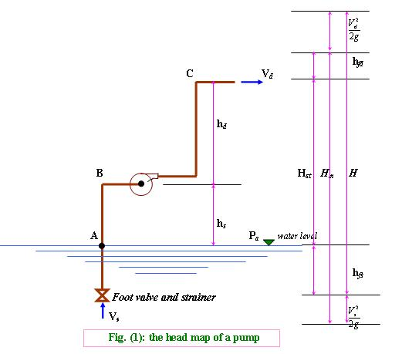
Heads of Pump:
where :
V_{s} = Velocity of fluid in the suction pipe.
V_{d} = Velocity of fluid in the delivery pipe.
h_{s} = Suction head.
h_{d} = Delivery head.
h_{fs} = head losses in the suction pipe.
h_{fd} = head losses in the delivery pipe.
Static head (H_{st})
H_{st} = h_{s} + h_{d}
10

Slide 22
Manometric head (H_{m}) :
but
and
(where )
where h_{f} = h_{fs} + h_{fd}
(where H_{L} = impeller losses)
Total head (H)
When V_{s} = V_{d}
Hence H_{m} = H
11

Slide 23
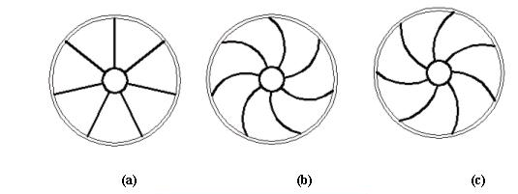
Type of Impeller
There are three main categories of impeller due type of impeller’s vane, which are used in the centrifugal pumps as;
Radial vanes, Fig. (a).
Backward vanes, Fig. (b).
Forward vanes, Fig. (c).
12

Slide 24
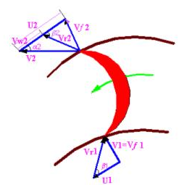
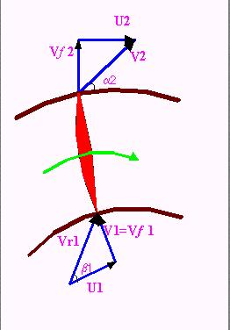
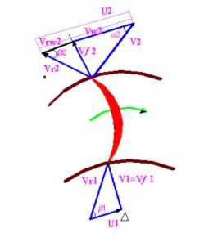
a) when β₂ > 90º, the Forwards curved vanes of the impeller.
b) when β₂ = 90º , the radial curved vanes of the impeller.
c) when β₂ < 90º, the Backwards curved vanes of the impeller.
where :
V = absolute velocity of the water.
U = Tangential velocity of impeller (peripheral velocity).
V_{r} = relative velocity of water to the wheel.
V_{f} = velocity flow.
N = Speed of impeller in (rpm).
13

Slide 25
Pump Performance Curve Mapping the Flow and the Head
Performance Curve
Most pump performance curves slope from left to right
Head
Pump Flow Rate

Slide 26
Pump Performance Curve Important Points
Shut-off Head
Shut-off Head is the maximum pressure or head the pump can produce
No flow is produced
Head
Pump Flow Rate

Slide 27
Pump Performance Curve Important Points
Maximum Flow
Maximum Flow is the largest flow the pump can produce
No Head is produced
Head
Pump Flow Rate

Slide 28
System Performance Curve
System Performance Curve is a mapping of the head required to produce flow in a given system
A system includes all the pipe, fittings and devices the fluid must flow through, and represents the friction loss the fluid experiences
The friction loss is mapped onto the graph
The amount of friction loss varies with flow through the system
Friction Loss
Head
Pump Flow Rate

Slide 29
The point on the system curve that intersects the pump curve is known as the operating point.
Head
Pump Flow Rate

Slide 30
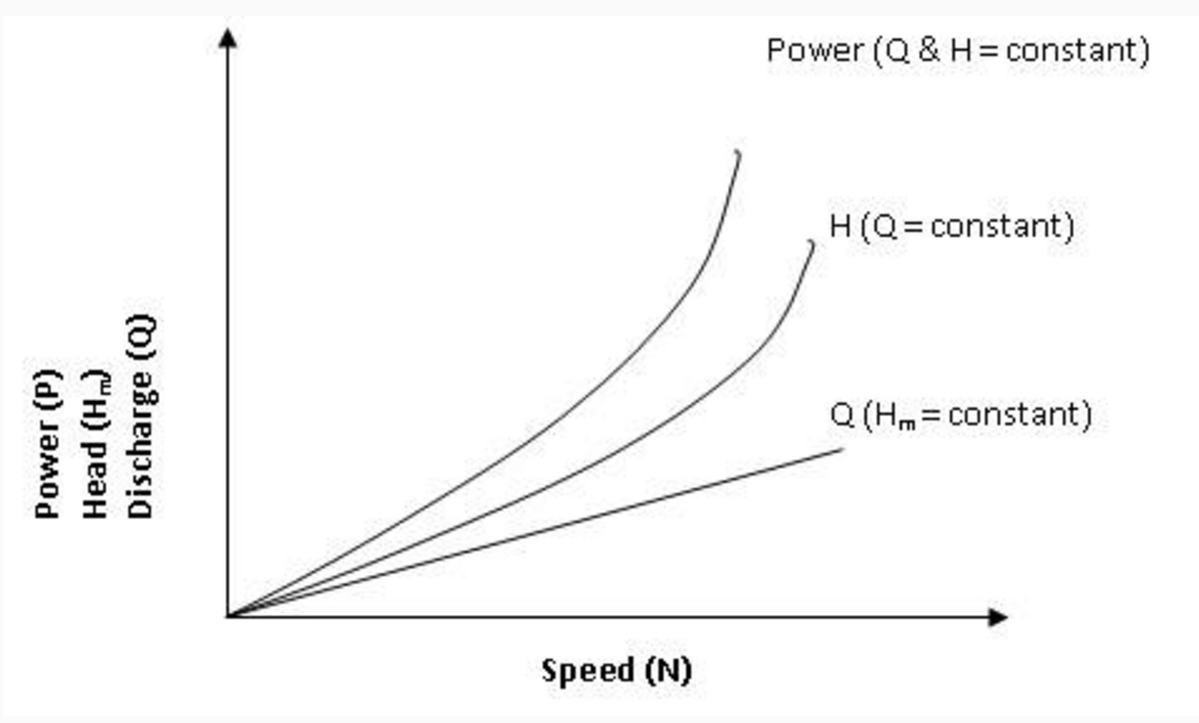
Pump Performance Curve
The main characteristic curves of a centrifugal pump consists of variation of head (h_{m}), power (P) and discharge (Q) with respect to speed

Slide 31
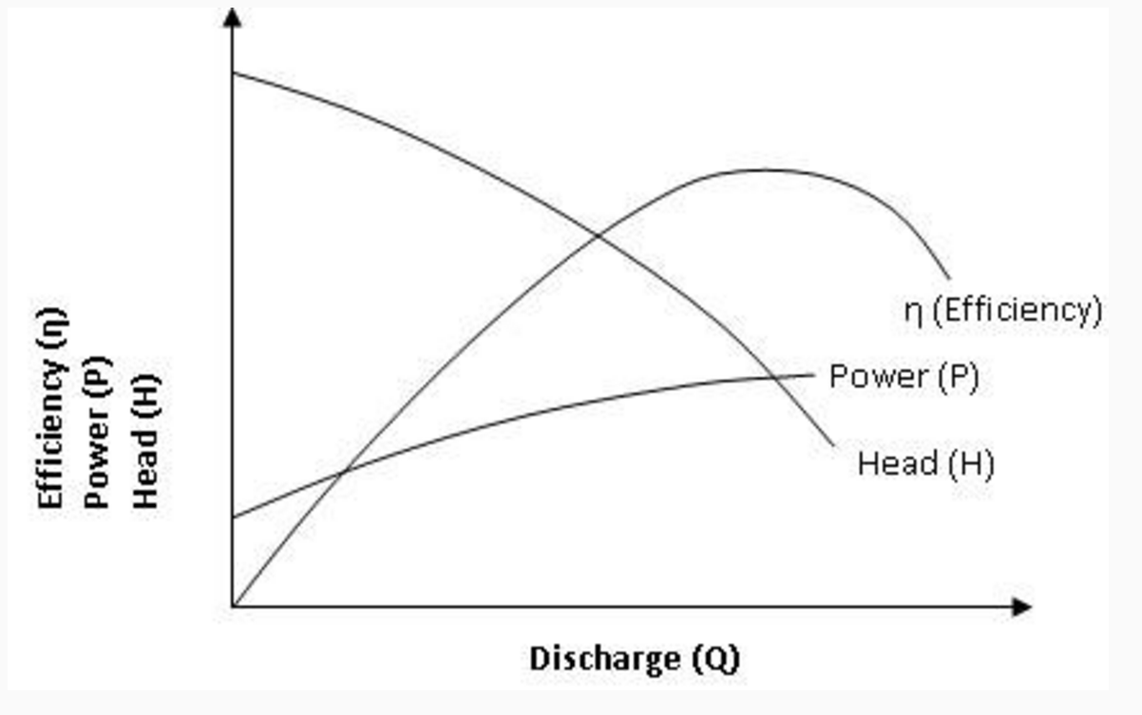
Pump Performance Curve
The operating characteristic curves is shown in fig

Slide 32
Theoretical Head Developed by an Impeller
Leakage and Recirculation Losses
Theoretical head (Euler head)
Head, H
Leakage/Recirculation losses
Flow rate, Q

Slide 33
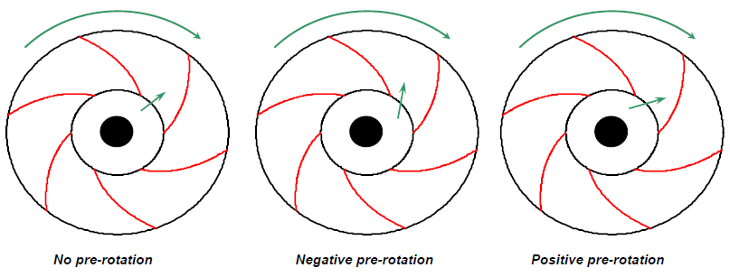
Theoretical Head Developed by an Impeller
Hydraulic Losses
Pumps are designed trying to achieve a no pre-rotation condition close to the best efficiency point, since this condition minimize shock-losses. In other words, shock losses increase as we move away from the BEP.

Slide 34
Theoretical Head Developed by an Impeller
Hydraulic Losses
Other losses including friction, mixing, change in direction of fluid, separation, etc. also contribute significantly to the total losses due to hydraulic.
Theoretical head (Euler head)
Head, H
Hydraulic losses
Flow rate, Q

Slide 35
Theoretical Head Developed by an Impeller
Friction Losses
Friction losses increases with increasing flowrate and viscosity.
Theoretical head (Euler head)
Head, H
Friction losses
Flow rate, Q

Slide 36
Theoretical Head Developed by an Impeller
Mechanical Losses
These losses include disk friction and frictional losses in bearings. The most significant loss is the thrust bearing loss. The mechanical losses do not have any effect on head and capacity of a pump but increase the brake hoursepower.

Slide 37
Theoretical Head Developed by an Impeller
Total Losses
Theoretical head (Euler head)
Hydraulic losses
Head, H
Friction losses
Actual Head
Leakage/Recirculation losses
Flow rate, Q

Slide 38
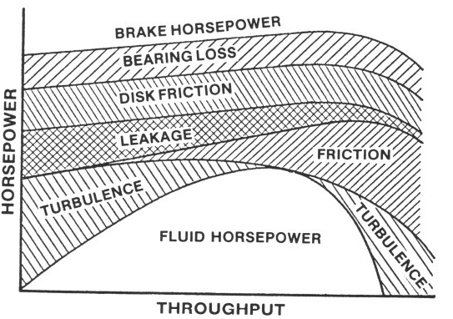
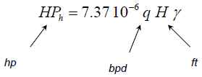
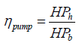
Theoretical Head Developed by an Impeller
Horsepower
The hydraulic horsepower is the energy transmitted to the fluids by the pump.
The break horsepower is the energy required by the pump shaft to turn. Some of this energy is dissipated inside the pump.
The ratio between the hydraulic horsepower and the break horsepower is the pump hydraulic efficiency.

Slide 39
Theoretical Head Developed by an Impeller
Pump Performance
In practice, a pump is tested by running it at a constant speed and varying the flow by controlling the choke. During the test, Q, DP, and the break horsepower are measure at several points. The DP is then converted to head and the overal efficiency of the pump is calculated. Based on these data, we can develop the pump performance.
The performance curve of a centrifugal pump can be summarized in only one curve of head vs. flowrate for all low viscous fluids.

Slide 40
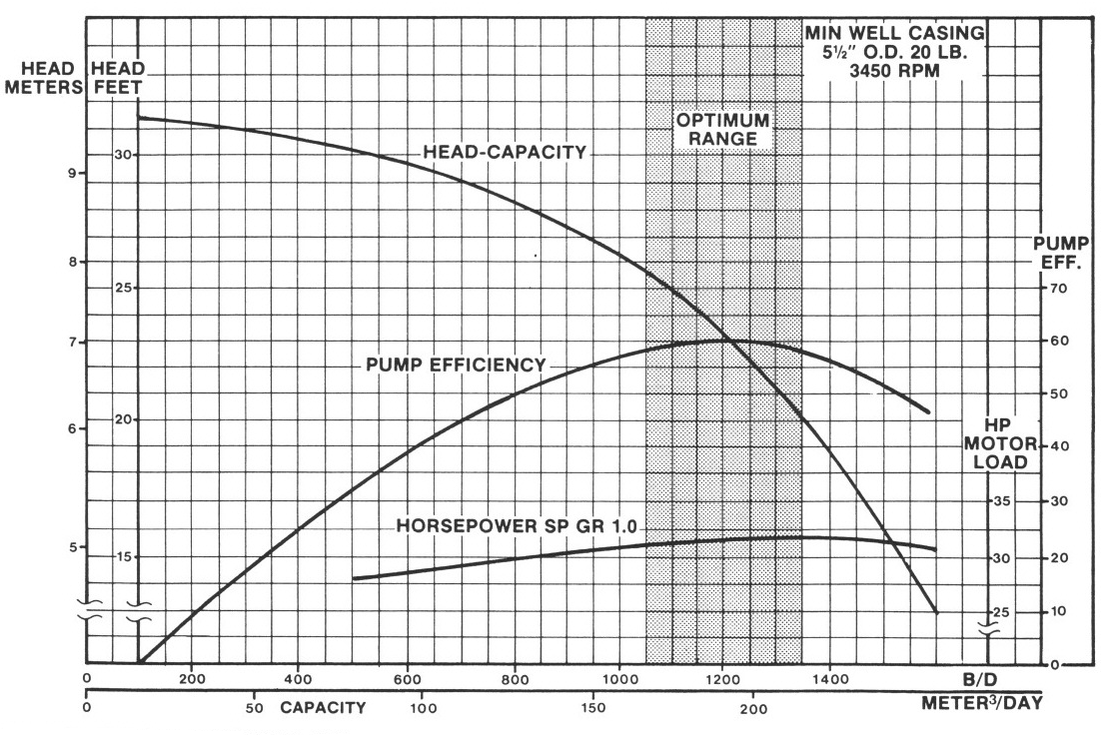
Theoretical Head Developed by an Impeller
Pump Performance

Slide 41
Pump Efficiency
Pump efficiency, η (%) is a measure of the efficiency with which the pump uses the input power to convert the energy into useful output.
η = P_{out}/P_{in}
where
η = efficiency (%)
P_{in} = power input
P_{out} = power output

Slide 42
Pump Efficiencies
1- Hydraulic Efficiency (ζ_{h})
The normal value varies between 60% - 90%
2- Manometric Efficiency(ζ_{m})
3 -Volumetric Efficiency (ζ_{v})
The normal value lies between 97% to 98%
14

Slide 43
4- Mechanical Efficiency (ζ)
It is due to losses in the shaft, coupling, and other operation losses as vibration
The normal value is 95% - 98%
5 - Overall Efficiency (ζ_{o})
The normal value is 71% - 86%
15

Slide 44
6- Power Required to Drive a Centrifugal Pump
(hp)
(hp)
7 -1 Cavitation
Cavitation is defined as the phenomenon of formation of vapor bubbles of flowing liquid in a region where the pressure of the liquid falls below its vapor pressure and the sudden collapsing of this vapor bubbles in a region of higher pressure. When the vapor bubbles collapse, a very high pressure is created. The formation and the collapse of a great number of bubbles on the surface produce intense local stresses that damage the surface by fatigue. It may occur at the entry to pumps or at the exit from hydraulic turbines in the vicinity of the moving blades
7 -2 Cavitation processes in centrifugal pump
The cavitation phenomenon develops in the impeller pump, when the pressure of liquid falls below the saturated vapor pressure at the prevailing temperature ( P_{s}< P_{v} of liquid), small vapor bubbles begin to form and the dissolved gases are evolved. The vapor bubbles are caught up by the following liquid and swept into a region of higher pressure, where they condense. Condensation takes place violently, accompanied by a tremendous increase in pressure, which has the character of water hammer blows. These impact follow each other in rapid succession, the vapor bubbles bursting both in the immediate vicinity of the surface attacked and in the pores causing cavitation pitting with many effecting.
16

Slide 45
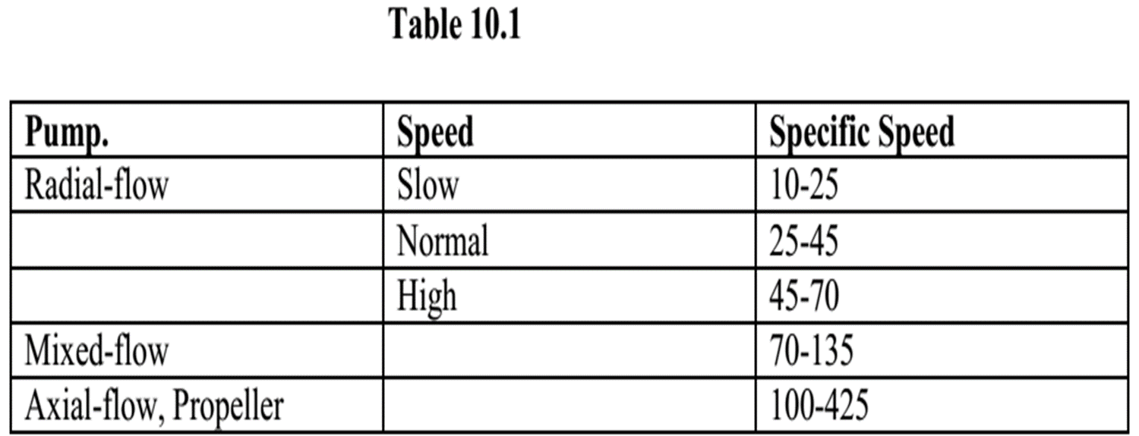
Specified Speed
Specific speed of a pump is defined as the speed of a geometrically similar pump which delivers unit discharge under unit head.
Ns = N√ Q / H^{3/4} --------------------------(10.4)

Slide 46
Selection of pumps:
Pumps are selected in the basis of their essential data:
No. of units required
Nature of liquid to be pumped
Capacity
Suction condition
Discharge condition
Total head
Service
Power
Space, weight, transportation
Location of installation
Others: special requirements as design, construction and performances.

Slide 47
A centrifugal pump delivers water at the rate of 1800 lpm,to a height of 20m, Through a 0.1m, dia, 80m. long pipe. Find the power required to drive the pump, if the overall efficiency is 65%, and Darcy’s friction factor=0.02.

Slide 48
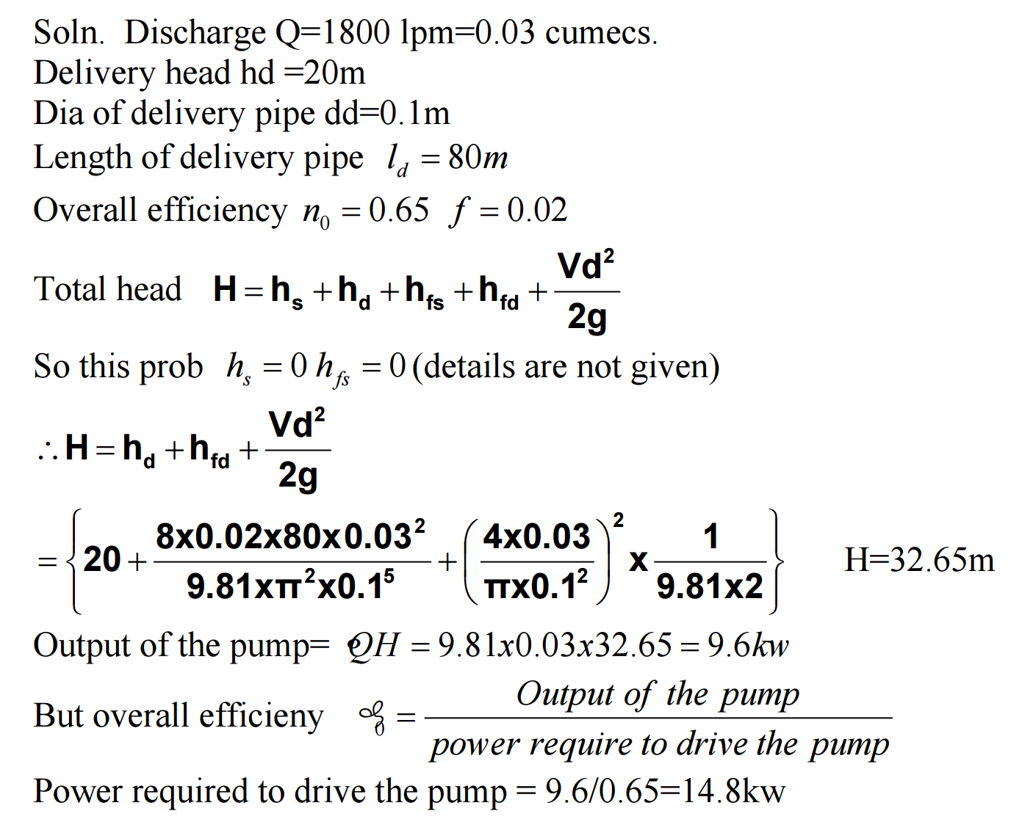

Slide 49
The following data refer to a centrifugal pump static head = 40m, suction height 5m, dia of suction and delivery pipes = 0.1m, loss of head in suction pipe = 2m, loss of head in delivery pipe = 8m, impeller dia at outlet =0.4m, impeller breadth at outlet 25mm.blades occupy 10% of the outlet area, speed 1200rpm. Exit angle of blade = 1500 with the tangent, Manometric efficiency = 80%, overall efficiency = 70%. Find the power required to drive the pump and what pressures will be indicated by the gauges mounted on the suction and delivery sides.

Slide 50
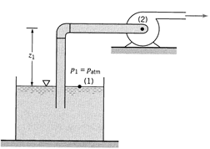
Net Positive Suction Head (NPSH)
Net Positive Suction Head Available (NPSH_{A}): The absolute dynamic head at the pump inlet (suction) in excess of the vapor pressure
NPSH_{A} is the theoretical amount of head that could be lost between suction and point of minimum pressure without causing cavitation (but this always overestimates actual amount that can be lost, because some velocity head must remain, even at point of p_{min}).

Slide 51
NPSH and Cavitation
Net Positive Suction Head Required (NPSH_{R}): The minimum value of NPSH_{A} that is needed to prevent cavitation in the pump, i.e., the value of NPSH_{A} that causes p_{min} to equal p_{vap}.
NPSH_{R} is determined experimentally by pump manufacturers and reported as a function of pump flow rate (usually called ‘capacity’).
To avoid cavitation, always operate with NPSH_{A} ≥ NPSH_{R}.

Slide 52
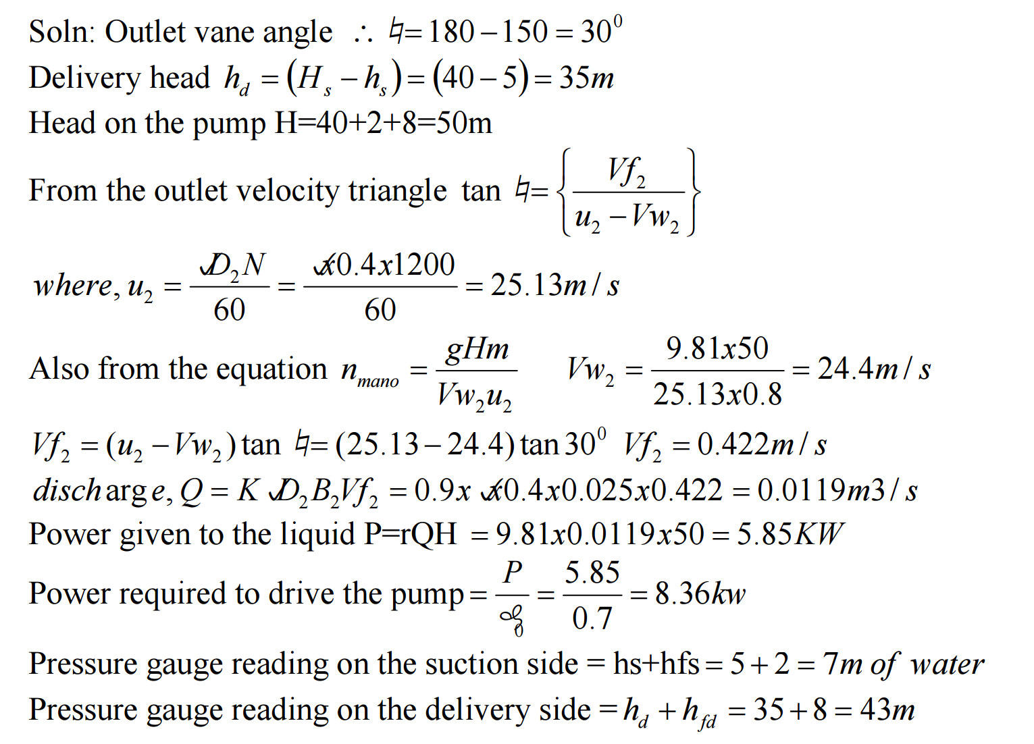

Slide 53
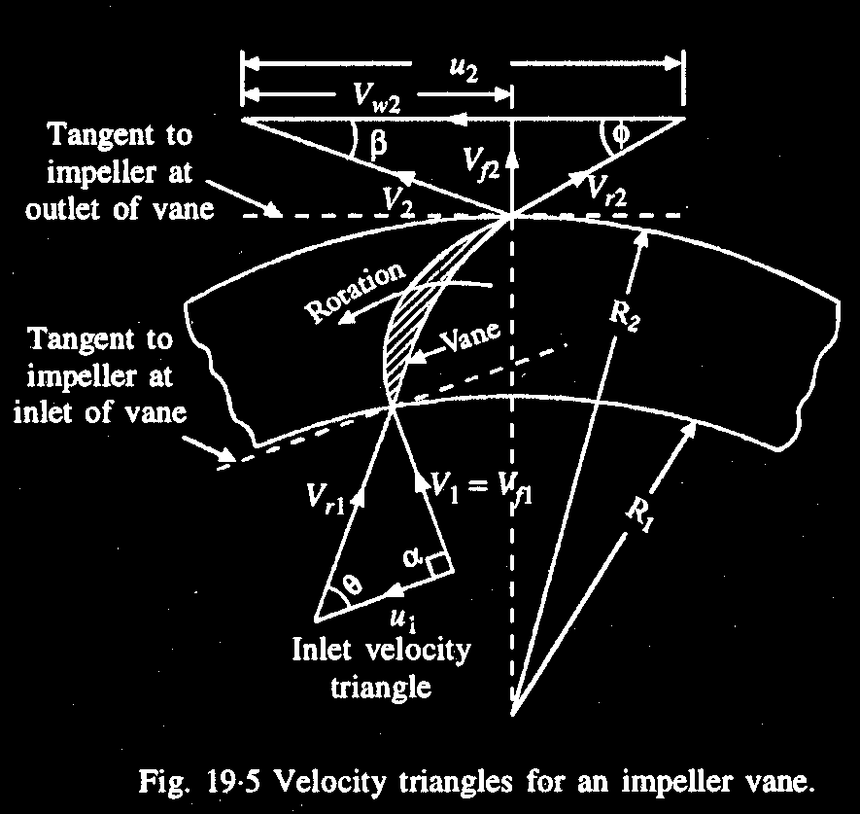

Slide 54
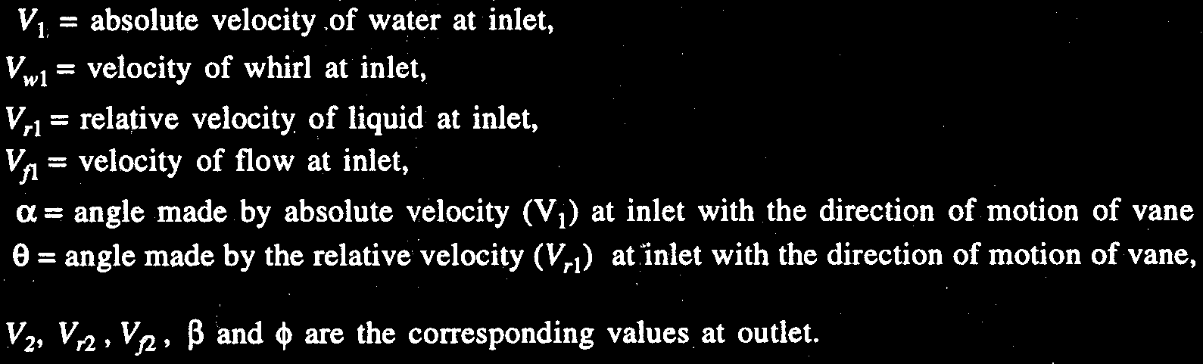

Slide 55
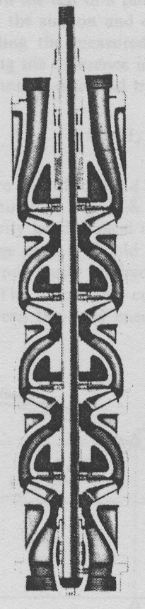
Deep well Turbine Pump:
2 or more impellers are arranged in series and vertical shaft
Q is same: H = n×H
Small dia of well casing ⇒
small dia of impeller ⇒
H developed in one stage is small ⇒ need no. of stages
Casing not concentric but volute ⇒
Water discharge to from one impeller to eye of other and need Diffuser vanes

Slide 56
Specific speed of pumps:
n_{s}= [n_{e}√Q] / h^{3/4}

Slide 57
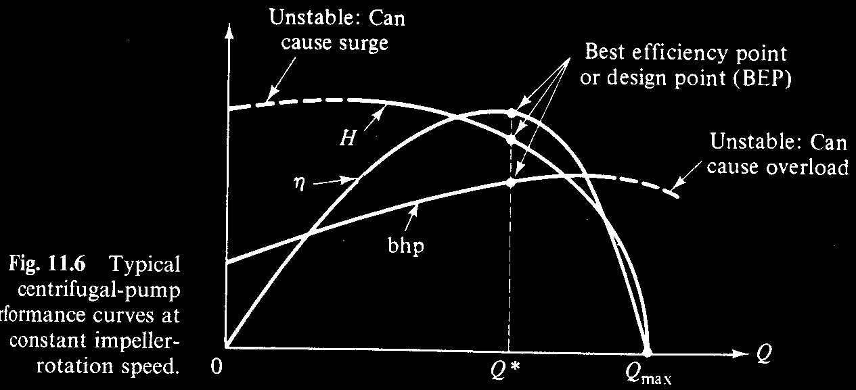
Operating point

Slide 58
Basic output parameters:
Assume: steady flow
Neglect viscous work and heat transfer
Velocity in inlet and outlet are uniform
Incompressible flow
Applying Bernoulli head,
H=(p/ρg + v²/2g +z)₂ - (p/ρg + v²/2g +z)₁ = h_{s} - hf------------------------------(1.1)
H = Head output generated by pump
h_{s} = Head supplied
h_{f} = Head loss
v₁ = v₂, and z₁ = z_{2,} usually
H=(p₂+p₁)/ρg

Slide 59
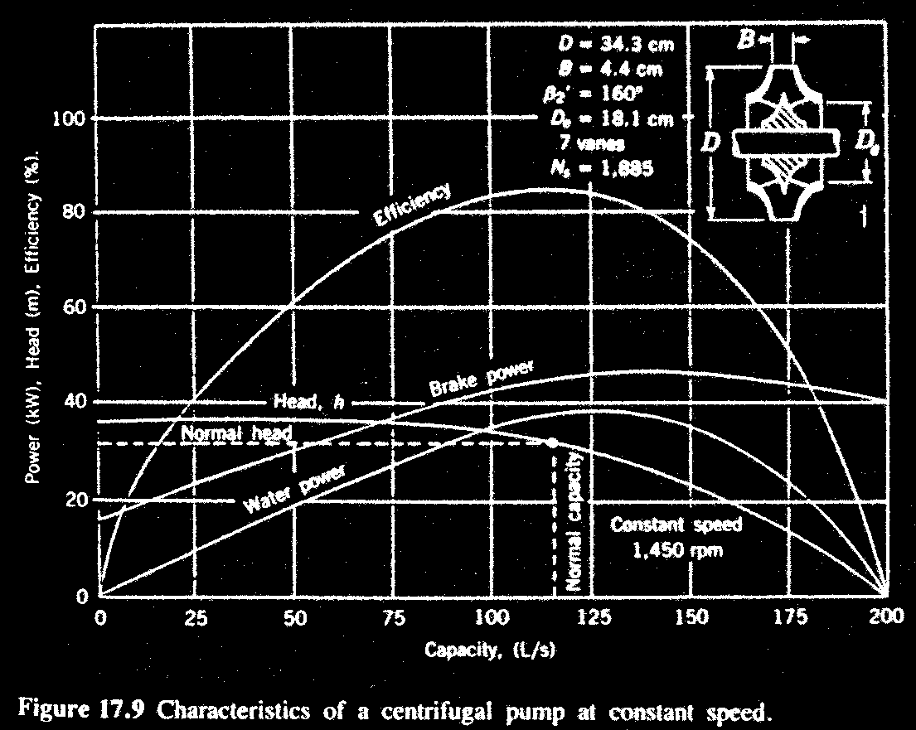
H vs Q curve may be transfer into for some other N by similarity laws (Q ∝ n and h ∝ n²) but η dec as it moves away from optimum N.
η dec. if pump is not operation at optimum pt. and dec depends upon how far the mode of opt.

Slide 60
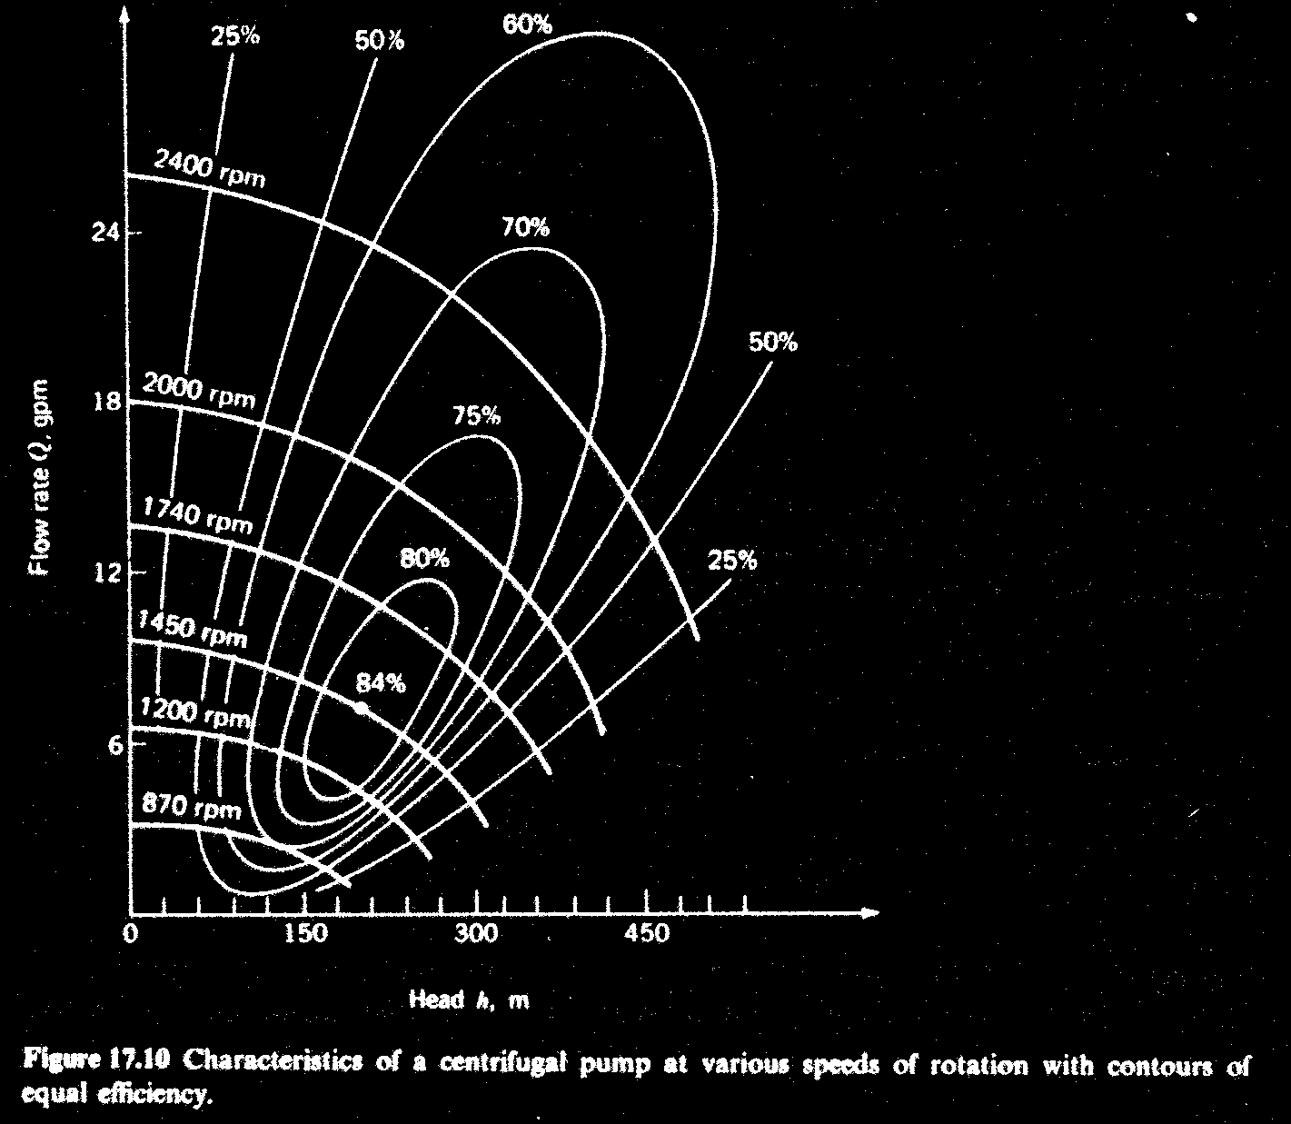

Slide 61
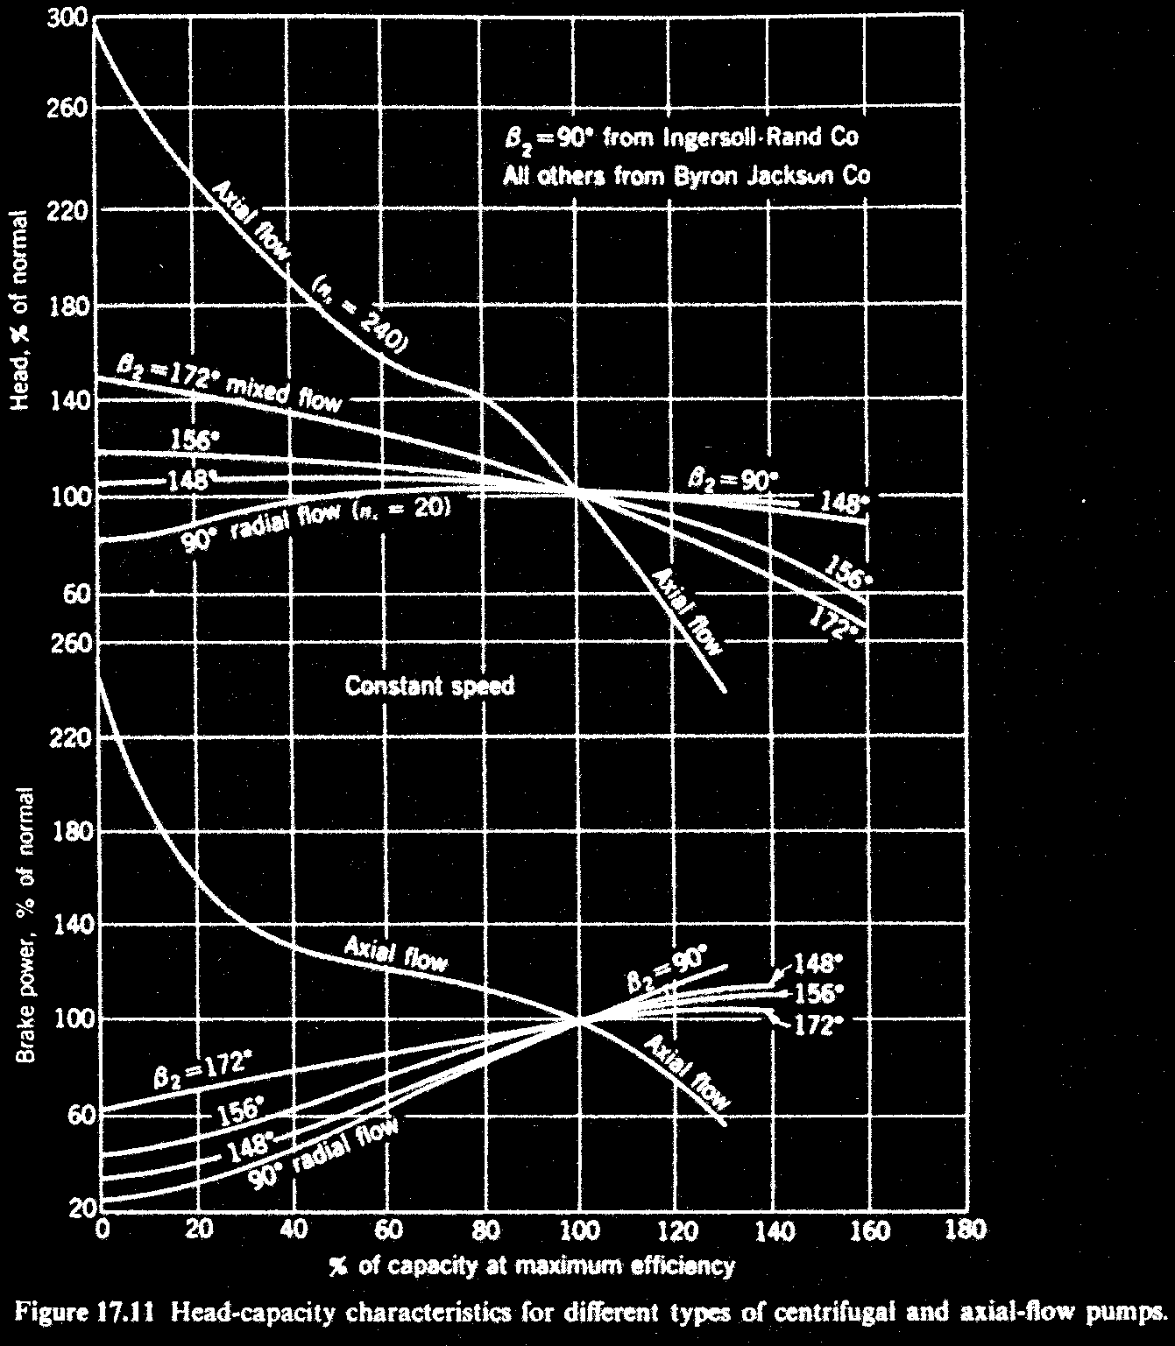
Flat char. shows variation in Q with little variation in H
Steep char. shows variation in H with little variation in Q
Axial/P has much steeper H-Q curve than Cent/P

Slide 62
H-Q curve:
Flat char. shows variation in Q with little variation in H
Steep char. shows variation in H with little variation in Q
Axial/P has much steeper H-Q curve than Cent/P
A/P ⇒ Break/P in high at shutoff but low even after η_{max}
( so not good and starting and cont operation at low capacity)
It is fixed blade type but can made adjustable blade as K/T to suit at low and other Q.

Slide 63
Energy losses in pumps:
Hydraulic loss:
Shock Loss: due to turbulence due to improper relative-velocity ∠ at vane inlet. It is large at (low and high) Q small at opt. cond.
Fluid friction Loss: due to passage between vanes. It varies as Q².
Circulatory loss at exist: due to difference in pressure on two sides of each vane. Almost constant wit respect to Q.
Mechanical Loss: due to bearing, packing and disk friction.
Leakage Loss
Power transmitted to impeller

Slide 64
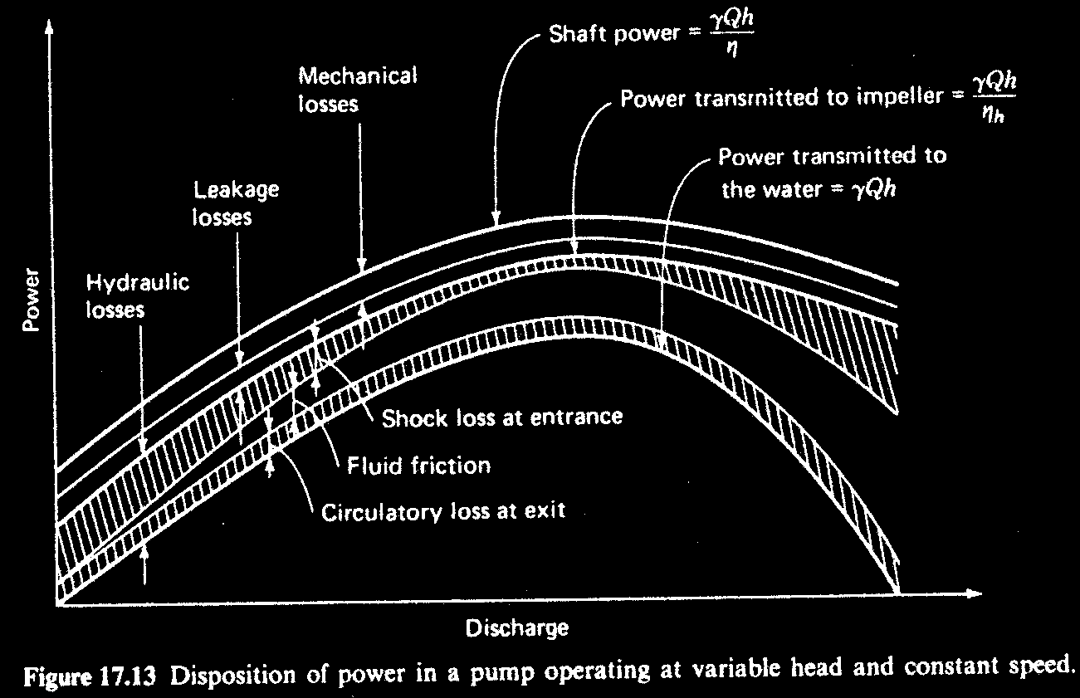

Slide 65
Cavitation in pumps:
Minimize this factor for satisfactory operation of pump( good η and prevention of impeller damage).
Cavitation Increase is indicated by drastic change in η.
It depends on operating condition and design of the pump.
It changes as change in H and Q.

Slide 66
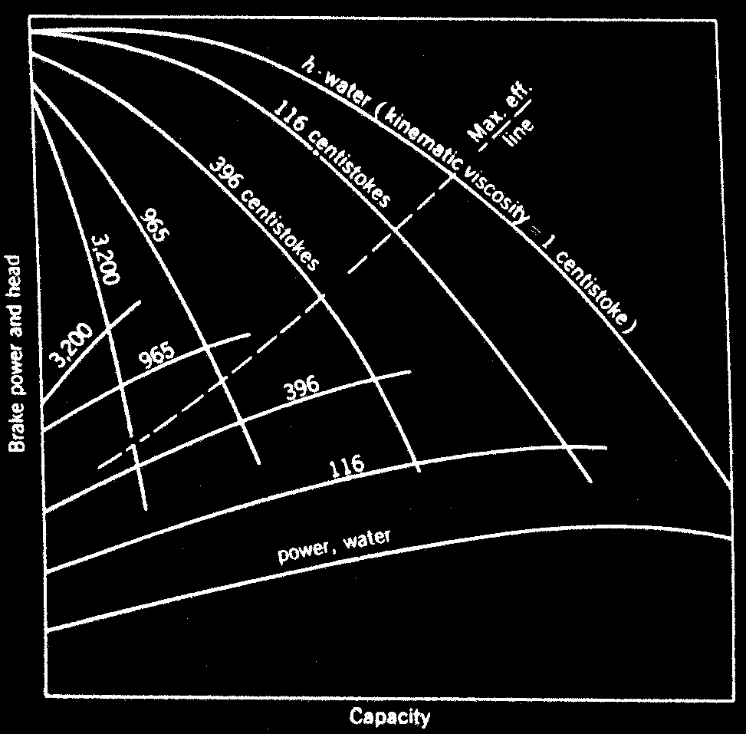
Effect of Viscosity in pumps:

Slide 67
Effect of Viscosity in pumps:
As Viscosity increases H-C curve become more steeper and power required increases.
The dash line indicates the max η for each V curve.
H and Q at point of max. V decreases as increase in V because of large increase in Break power.
If η_{opt} =0.85 for water then η_{opt} =0.47 when pumping a liquid of viscosity 116 times or centistoke.

Slide 68
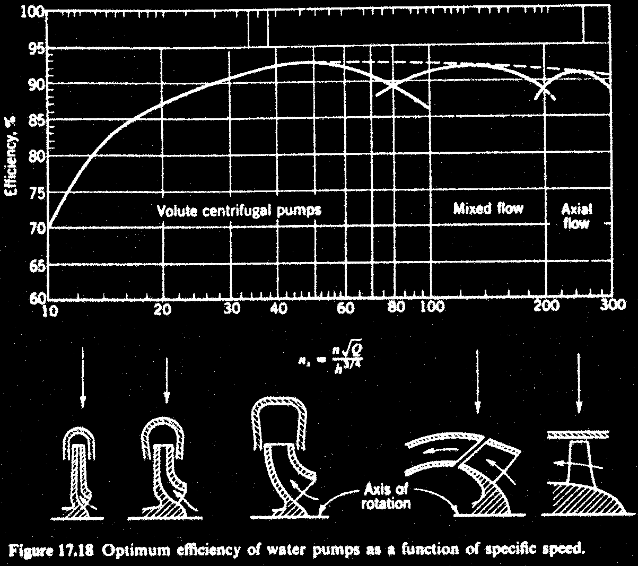
Efficiency of pumps:
η_{opt} for morden large pumps with runner profile and gradual merginig from one type to other.
η decreases as pump size decreases.

Slide 69
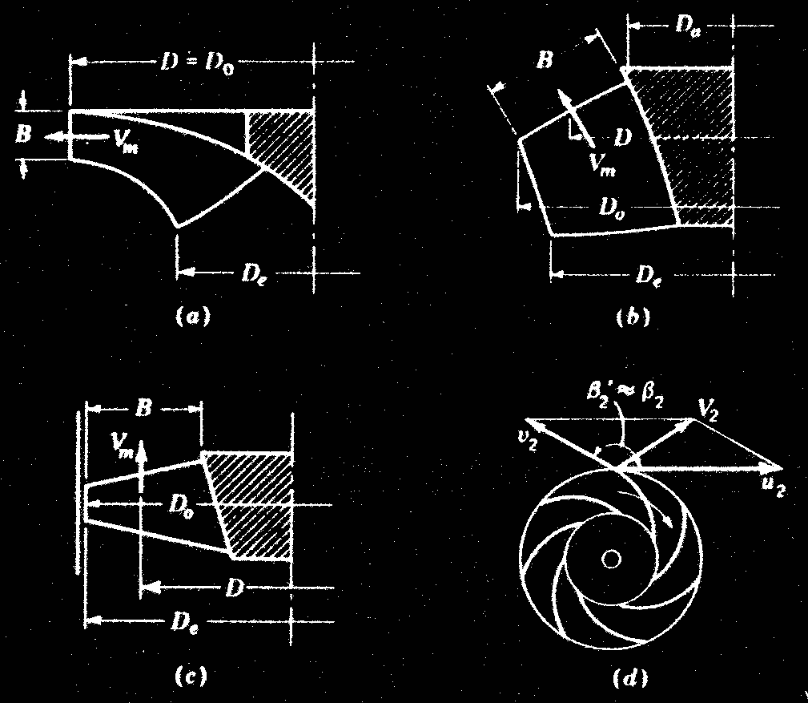
Calculation of Q and A for pumps:
The discharge = outlet area × av. Velocity
The effective area for radial(a) and mixed(b) flow impeller = fπDB
for axial(c) impeller = fπD_{e}²/4

Slide 70
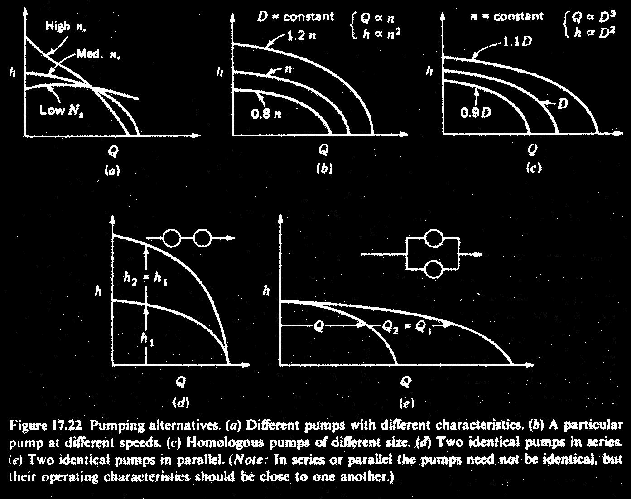

Slide 71
Selection of pumps:
Pumps are selected in the basis of their essential data:
No. of units required
Nature of liquid to be pumped
Capacity
Suction condition
Discharge condition
Total head
Service
Power
Space, weight, transportation
Location of installation
Others: special requirements as design, construction and performances.

Slide 72
System characteristics for pumps:
Chose pump under normal cond^{n} of operation near to OP. If not loss of energy and uneconomic.
Criteria for chose of pump: design, sp speed, size, types
When pumps are connected in combination (series and parallel) need similar H-Q curve through out the range of operation.
One pump carry most of the load and under certain condition all of the load , with other pump as hindrance rather than help.
In parallel condition of back flow may occor.
Need to check cavitation problem.
Do by plotting pum charasteristic and pipe system charasteristic curve.
Select by changing speed or size. Speed change reduce η.

Slide 73
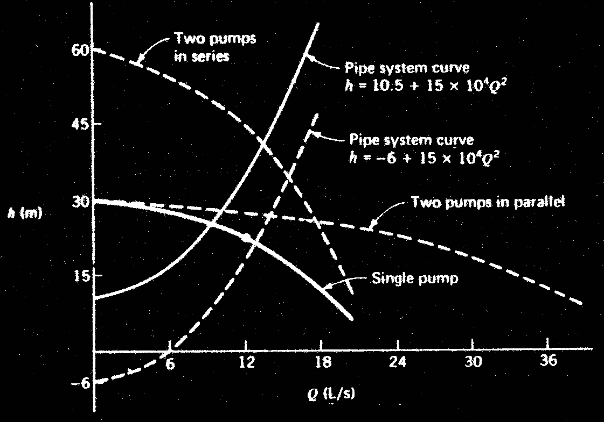

Slide 74
Advantages and Disadvantages of
Centrifugal Pumps
Centrifugal Pumps are the most widely used type of pump for the transfer of liquids. There are many advantages and disadvantages associated with Centrifugal Pumps:
Advantages:
Simple operation.
Low first cost and maintenance.
Insignificant excessive pressure build up in casing.
Impeller and shaft are the only moving parts.
Quiet operations.
Wide range of pressure, flow and capacities.
Utilize small floor space in different positions.

Slide 75


Advantages and Disadvantages of
Centrifugal Pumps Continued…..
Disadvantages:
High viscous liquids are not handled well.
Centrifugal Pumps usually don’t have the capabilities of handling high pressure applications in comparison to other types of pumps, i.e., Regenerative turbines.
In general, Centrifugal pumps cannot deliver high pressure without changes in design and are not suitable for high pressure delivery at low volumes except the multistage pumps.

Slide 76
Thank You.

Slide 77


Slide 78


Slide 79


Slide 80


